Slide 1


Introduction to Pygame
Presented by:
ACM at University of Southern Indiana
Jakobie Brown

Slide 2
Requirements
Python
Download python from
https://www.python.org/downloads/
Run the installer:
Windows: Ensure “Add Python to Path” is checked when installing
A plain text editor and a shell environment
-or-
An Integrated Development Environment (IDE)
VS Code
Etc..

Slide 3
Set Up
Download or clone repository from
https://www.github.com/JakobieBrown/PygameIntro
(link in discord)
Open the directory in a terminal or IDE
Install pygame.
In your terminal type:
pip install pygame

Slide 4
Initializing Pygame
import pygame
Import the pygame module
pygame.init()
Required before using pygame
pygame.display.set_mode((WIDTH,HEIGHT))
Creates a window with a pygame.Surface of the desired size
while True:
Loop forever

Slide 5
Handling Events
Without handling events, the program is unresponsive.
Windows: press ‘ctrl’ + ‘c’ in the console to kill the program
Mac: press ‘⌘’ + ‘.’
Get a List of the events in the main loop:
events = pygame.event.get()
Iterate through the events:
for event in events:
if event.type == pygame.<event type>:

Slide 6
Quitting Pygame
pygame.quit()
The opposite of pygame.init()
quit() safely uninitializes all pygame modules
After calling quit(), pygame will no longer work
Quit Event
The quit event is triggered when the user presses close on the window.
Check for this event in the event loop
if event.type == pygame.QUIT:
pygame.quit() # quit pygame
exit() # exit program

Slide 7
Setting FPS
pygame.time.Clock
Used to manage timing and the frame rate
Create a clock instance
clock = pygame.time.Clock()
In the main loop:
clock.tick(30) # sets the framerate to 30 fps

Slide 8
Rendering Images
Pygame renders images with pygame.Surface.
Surfaces are drawn on the main surface with
main_surface.blit()
In the main loop call pygame.display.update() to re-render the surfaces
Pygame axis begins at the top left
+x is to the right
+y is downward

Slide 9
Pygame Surface
pygame.Surface
Used to draw images on the pygame window
Four “types” of surfaces
Basic surface
Main surface
The base surface all other surfaces are drawn on top of
Image surface
Used to display image data
Text surface
Used to render text
Surface.blit(surface, rect)
Used to draw any surface to any other surface

Slide 10
Pygame Surface
Main Surface
screen = pygame.display.set_mode((width,height))
Named screen by convention
Basic Surface
surface = pygame.Surface((width,height))
surface.fill(color) #fill surface with a color
Image Surface
image = pygame.image.load(path/to/image)
.convert_alpha() # converts the image to a usable format and preserves the alpha value.

Slide 11
Pygame Surface
Text Surface
Rendered from a Font object
text_surface = font.render(txt, antialias, color, bg_color)
Font
font = pygame.font.Font(path/to/font | None, size)
font = pygame.font.SysFont(“FontName”, size, bold, italic)
Example (drawing a surface to the main surface)
box = pygame.Surface((32,32)) #create 32x32 square
box.fill(“blue”) #fill square with blue
screen.blit(box,(x,y,w,h))#draw surface to screen

Slide 12
Pygame Rect
Rectangles in pygame are very useful
They’re used to:
Accurately place and move surfaces
Detect collisions
image = pygame.image.load(path).convert_alpha()
Image_rect = image.get_rect() # create rect from image
screen.blit(image,image_rect) # blit image to screen

Slide 13
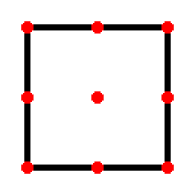
Pygame Rect
Using rects enables us to place images accurately without using geometry
rect = surface.get_rect(point* = (x,y))
This enables you to set a point of the rect to a specific coordinate values.
topleft midtop topright
midleft center midright
bottomleft midbottom bottomright
Example (draw text in top right corner)
txt = font.render(txt,True,’white’, None)
rect = txt.get_rect(topright = (screen_width, 0)
screen.blit(txt,rect)

Slide 14
Animation (movement)
Motion in videos is caused by changing the position of an image over time.
The rects we set up for our images will make this very simple.
Example:
image = pygame.image.load(path)
rect = image.get_rect()
speed = c
while True:
rect.x += speed
screen.blit(image, rect)

Slide 15
Animation (movement): 2-Dimensional
For 2-dimensional movement:
Deal with components separately
Cos is for x
Sin is for y
Example:
direction = (direction + delta_dir) % 360
velocity.x += cos(direction)
velocity.y += sin(direction)
position.x += velocity.x
position.y -= velocity.y # inverted y-axis

Slide 16
Collision Detection
Rects enable us to check for collisions between two rects
rect.colliderect(other_rect)
Returns Boolean value to indicate if rects overlap
Problem: Calling this for all possible colliding rects would be tedious and/or inefficient

Slide 17
Key Events
Pygame provides an interface that triggers events when keys are pressed
To respond to these events we listen for them in the event loop.
for event in pygame.event.get():
if event.type == pygame.KEYDOWN:
if event.key == pygame.K_<key>:
#do something
elif event.type == pygame.KEYUP:
if event.key == pygame.K_<key>:
#do something

Slide 18
Surface Transformation: Rotation
pygame.transform.rotate(surface, angle)
Returns the transformed surface
Angle is in degrees
Keep an unaltered surface to transform to avoid issues
Reset center after rotation
+angle: counterclockwise
-angle: clockwise
Example
image = pygames.image.load(path).convert_a...
rect = image.get_rect(center = (x,y))
rotated = pygame.tansform.rotate(image, angle)
rect = rotated.get_rect(center = rect.center)

Slide 19
Surface Transformation: Scale
pygame.transform.scale(surface, 2d size)
Scales surface to the size provided
Size is two values (w,h)
pygame.transform.scale2x(surface)
Scales the surface by a factor of two
pygame.transform.scale_by(surface, factor)
Scales the surface by the factor provided
Same tips for rotation apply to scale
Example:
image = pygames.image.load(path).convert_a...
rect = image.get_rect(center = (x,y))
scaled = pygame.tansform.scale(image, size)
rect = scaled.get_rect(center = rect.center)

Slide 20
Physics based movement: Acceleration & Velocity
So far, we have moved our surfaces by a constant amount
To emulate kinematic motion, we can move our surface by variable amount
To accomplish this, we’ll use two values. Acceleration and velocity.
In the main loop:
acceleration += c #constant
velocity += acceleration
position += velocity
This has the effect of “gaining speed” over time
It works great for a frictionless environment

Slide 21
Physics based movement: Drag
With the acceleration and velocity working together to move the surface, you’ve probably noticed it becomes too fast
To fix this we need to create a terminal velocity
Terminal velocity occurs when the fricative force becomes large enough to oppose the accelerating force, making acceleration drop to zero and causing the velocity to become constant
Example:
friction_coeff = .04
acceleration += c
velocity += acelleration
friction = friction_coeff*velocity
velocity -= friction
As the velocity grows, so does the friction eventually reaching terminal velocity

Slide 22
Basic Game States
Creating a basic game state is simple
We change what happens in the main loop
Example:
active = boolean
while True:
if active:
# play game
else:
# show start screen

Slide 23
Mouse Events
Pygame provides an interface that triggers events from the mouse
event.pos # position of mouse in a mouse event
Mouse Events
pygame.MOUSEDOWN #when mouse button is pressed
pygame.MOUSEUP #when mouse button is released
event.button # represents which button was pressed/released
Left-click: 1 | Wheel-click: 2 | Right-click: 3
Wheel-scroll up: 4 | Wheel-scroll down: 5
Pygame.MOUSEMOTION
event.rel # change in position
pygame.WHEEL
Event.y # how much the wheel scrolled vertically
Event.x # how much the wheel scrolled horizontally

Slide 24
Shapes and lines
Pygame provides an interface for drawing shapes and lines on surface
Example
pygame.draw.line(surface, color, start, end, width)
Example
rect = (x,y,w,h)
pygame.draw.ellipse(surface,color,rect)

Slide 25
Colors
In graphic art we use additive colors Red, Blue, and Green
Any color can be made by combining red, blue, and green at varying values
Red, Blue, and Green can be values in range [0-255]
Numbers can be represented with hexadecimal values [000000 – FFFFFFF]
Pygame handles colors in 3 different ways
By a 3 integer tuple: (R,G,B)
By a hexadecimal string: ‘#RRGGBB’
By the name of the color: ‘color_name’

Slide 26
Colors
Examples
red = pygame.Color((255,0,0))
blue = pygame.Color(‘#0000FF’)
green = pygame.Color(‘green’)
Alpha Value
Colors also have an Alpha value in range [0-255] that determines the transparency of the color
Example
transparent_red = pygame.Color((255,0,0,128))
transparent_blue = pygame.Color(‘#0000FF80’)

Slide 27
Sounds
Load sound:
sound = pygame.mixer.load(‘path/to/sound’)
Adjust volume:
sound.set_volume(percentage)
Play Sound once:
sound.play()
Play Sound multplie times:
sound.play(n) #plays sound n times
Loop forever:
sound.play(-1)
Stop:
sound.stop()

Slide 28
Sprite class
The sprite class is used to unify the surface and the rect under one object
Example
class Player(pygame.sprite.Sprite):
self.__init__(self):
super().__init__()
self.image = pygame.Surface((w,h))
self.rect = self.image.get_rect()
self.image and self.rect are required attributes in a pygame Sprite
This may seem no different than if you were to create a class, but the real advantage is when you put sprites into groups.

Slide 29
Sprite Groups
A group in pygame is a collection of sprites
Pygame has two types of sprite groups
Group for multiple sprites
GroupSingle for a single sprite
Group has a draw method that uses a sprites, image and rect to draw the sprites on a surface
Group has an update method that calls the update method of sprites in the group
Creating groups:
player_group = pygame.sprite.GroupSingle()
Projectile_group = pygame.sprite.Group()

Slide 30
Sprite Groups
Drawing sprites in a group to screen:
player_group.draw(screen)
Updating sprites:
class Player(pygame.sprite.Sprite):
self.__init__(self):…
def update(self):
#update player
player_group.update()
Referencing Sprites in groups:
player = player_group.sprite # for GroupSingle
projectile = projectile_group.sprites # List, for Group

Slide 31
Spawning Objects
Now that we have our groups and sprites drawing to the screen
We can spawn objects simply by adding them to their group.
player_group.add(Player())

Slide 32
Group Collision
One of the largest benefits of Sprite Groups is to efficiently handle collisions
To check for collisions between two sprite groups:
GroupSingle:
pygame.sprite.spritecollide(group.sprite, other_group, bool)
If bool is true, the sprite from other_group is destroyed
Returns a list of sprites in other_group detected in the collision
Group:
pygame.sprite.groupcollide(groupA, groupB, destroyA, destroyB)
Returns a Dict of <spriteA, List<sprite>>

Slide 33
Group Collision
Examples:
Single collide with group
for sprite in pygame.sprite.spritecollide(a.sprite, b, False,):
print(f’{a.sprite} collided with {sprite}”)
Group collide with group
for sprite_a, list_b in pygame.sprite.groupcollide(a,b,False,False).items():
for sprite_b in list_b:
print(f’{sprite_a} collided with {sprite_b}’)

Slide 34

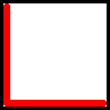
Pixel-perfect Collisions
At this point you may have noticed the collisions look a bit strange.
This is caused by how colliderect() behaves
colliderect checks if the rects are overlapping and returns true if they are
Collision!

Slide 35
Pixel-perfect Collisions
To fix this, we’ll use masks.
Creating a mask:
image = pygame.image.load(path)…
mask = pygame.mask.from_surface(image)
Comparing masks:
a.mask.overlap(b.mask, offset) -> Boolean
The offset is the difference between the topleft coordinates of the two sprites
To correctly calculate this:
offset = (b.rect.left – a.rect.left,
b.rect.top – a.rect.top)

Slide 36
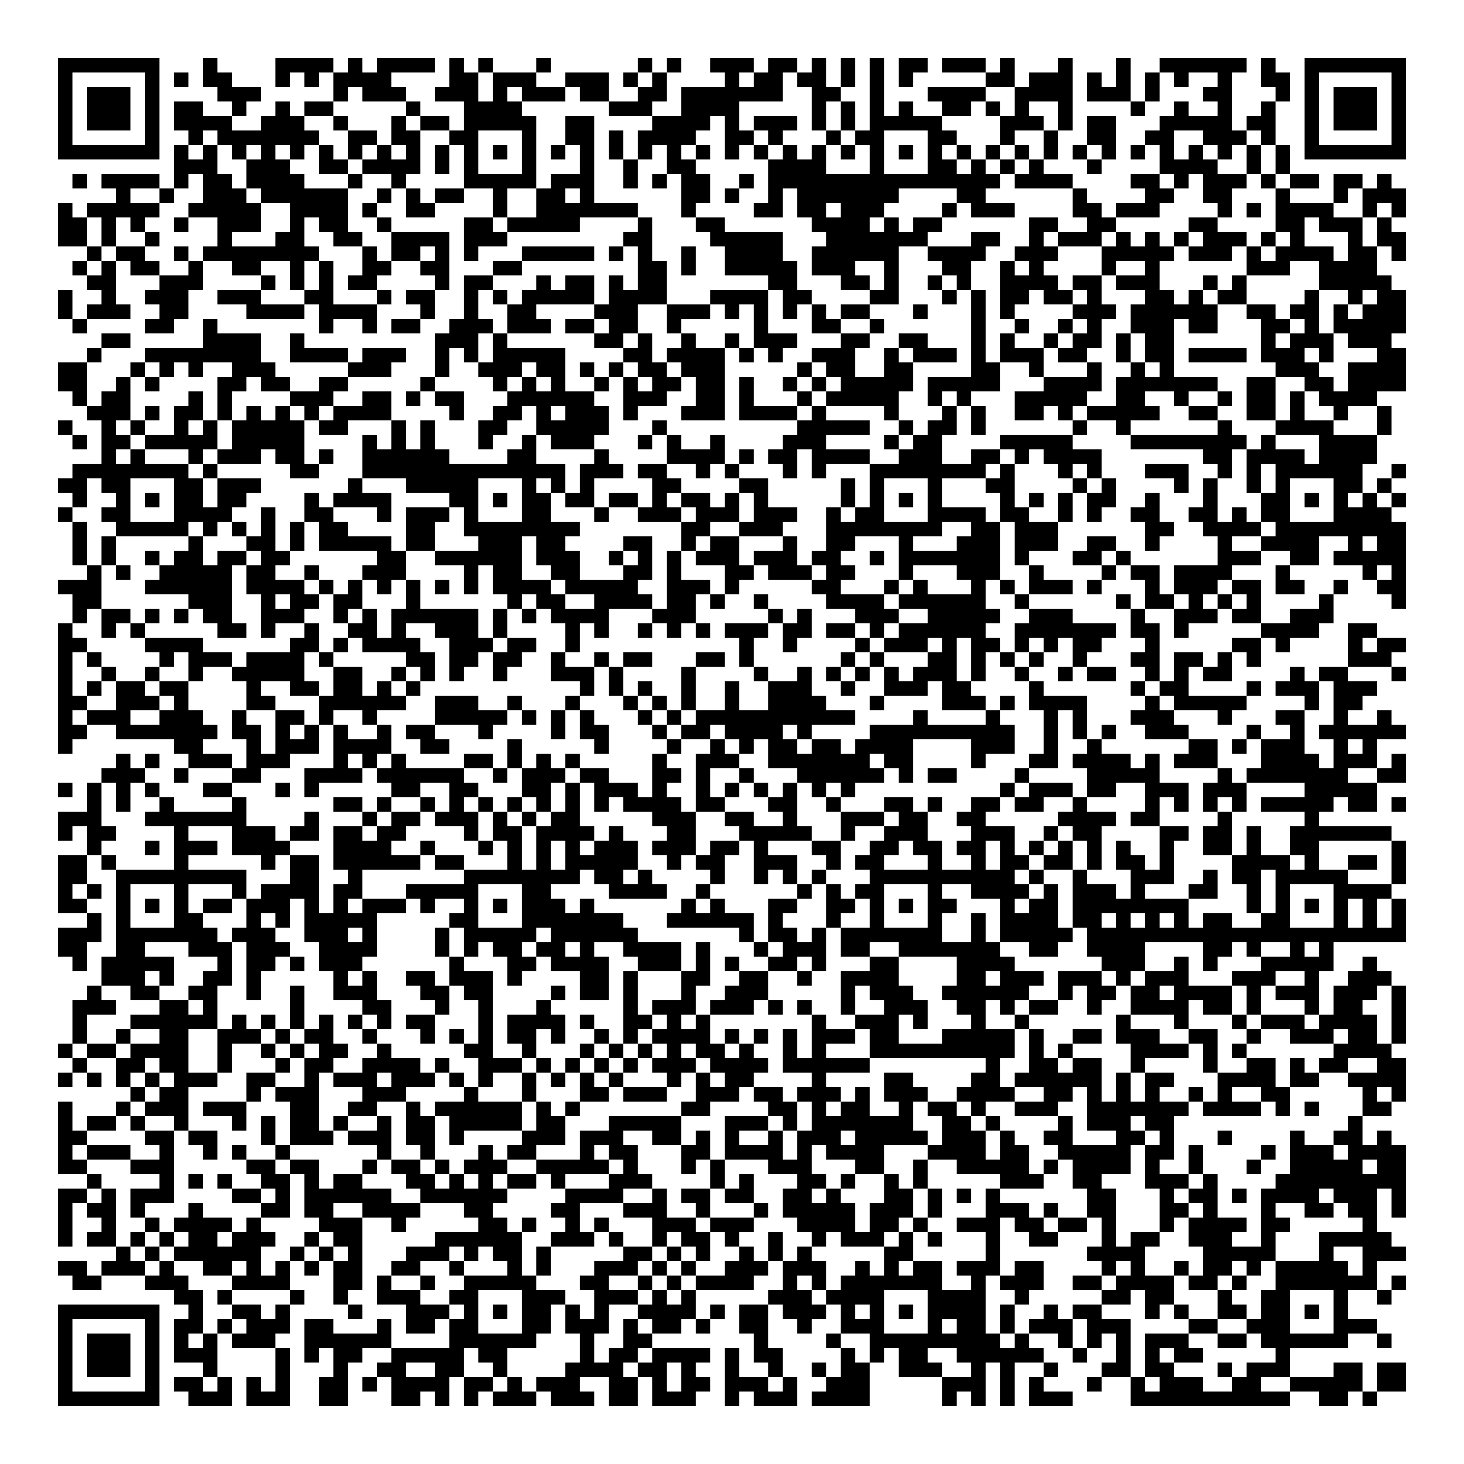
Attendance

Slide 37
Introduction to Pygame
Presented by:
ACM at University of Southern Indiana
Jakobie Brown

